Slide 1

DistLearn
Distributed Federated Learning
Abhinav Raundhal (2022101089)
Archisha Panda (2022111019)
Vinit Mehta (2022111001)

Slide 2

Introduction
What is Federated Learning?

Slide 3
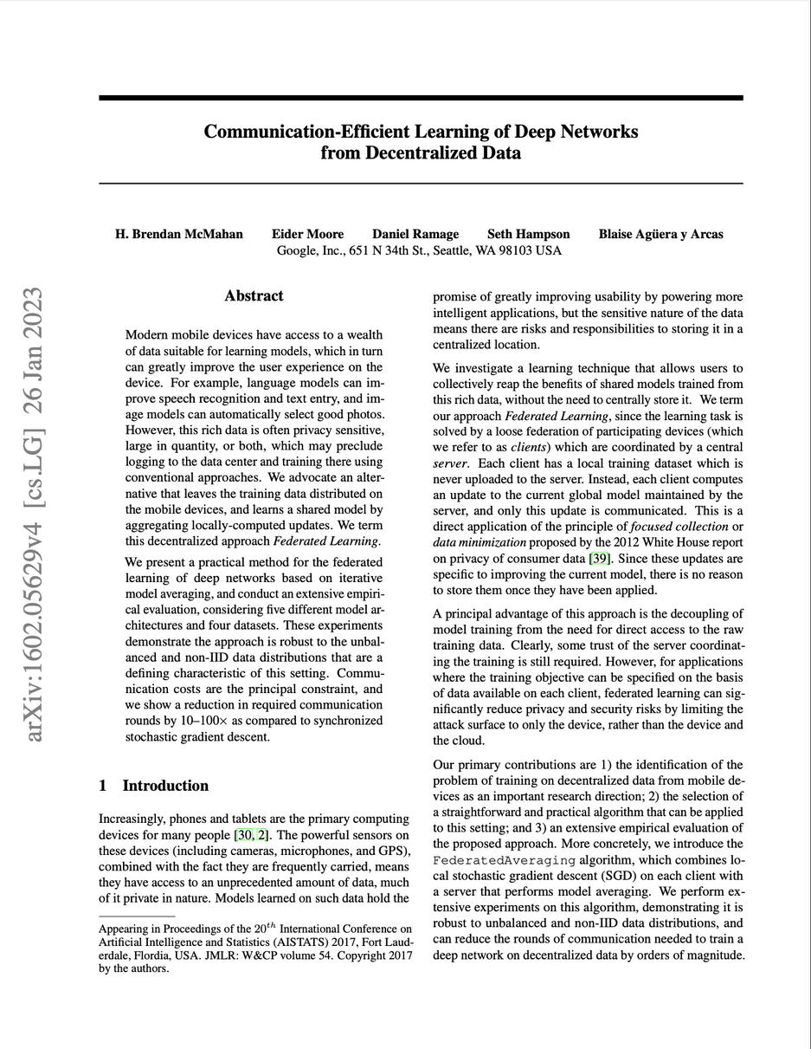
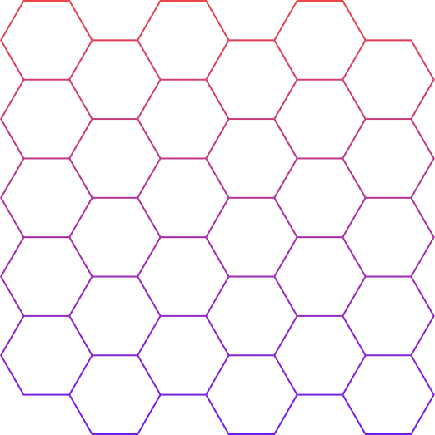

It all started with ...
Published in: PMLR
Year of Publish: 2017
Link: https://arxiv.org/pdf/1602.05629
Authors: H. Brendan McMahan, Eider Moore, Daniel Ramage, Seth Hampson, Blaise Aguera y Arcas (Google)
Federated Learning (FL) enables multiple clients to collaboratively train a global model without sharing raw data, preserving privacy and reducing data transfer costs. However, FL faces challenges like privacy risks, security threats, and high communication overhead. Our project aims to build a Distributed Federated Learning (DFL) system that addresses these issues to achieve scalable, secure, and communication-efficient training.
Compute Q and W vectors as in FRAME

Slide 4

System Architecture
How clients and server interact to train the global model.

Slide 5
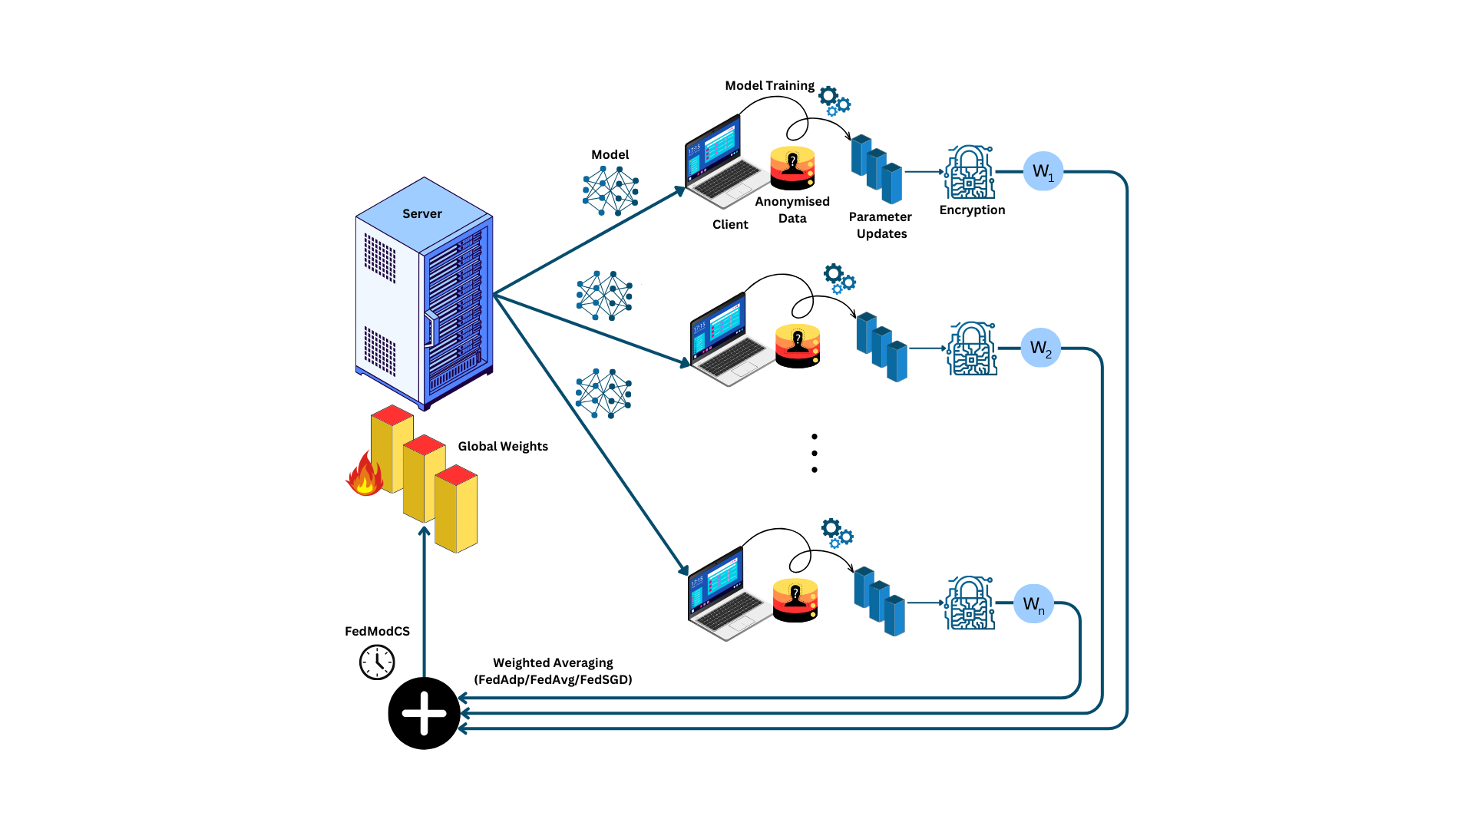
Send updated model to clients
Communication between clients and server is completely encrypted using SSL/TLS certificates
Manages the global model and aggregates local model updates.
Model Training at Client Level
Weights from all the clients are averaged based on the selected strategy

Slide 6
Tech Used
Different technologies used for implementation

Slide 7





Frameworks Used
01
Low-latency, scalable communication between server and clients using remote procedure calls
02
Dynamic discovery of active clients and services with fault tolerance and automatic registration
gRPC
Consul
03
Flexible deep learning framework with GPU acceleration and support for model building and training
04
Generates self-signed certificates and private keys for securing gRPC communication via TLS
PyTorch
Open-SSL

Slide 8
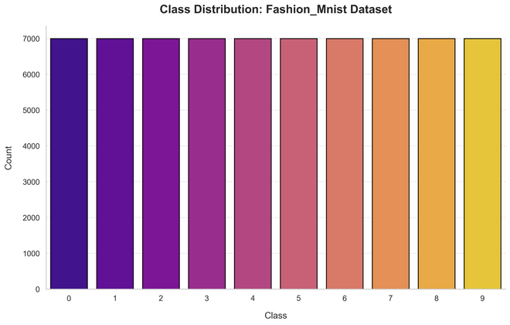
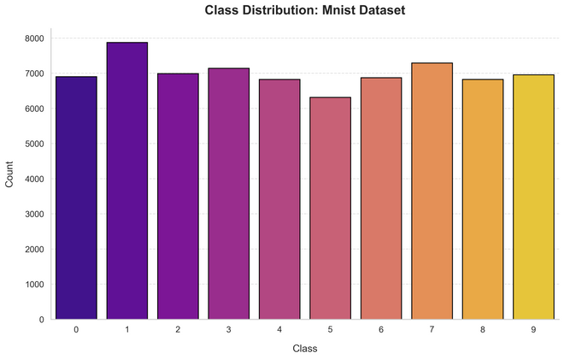
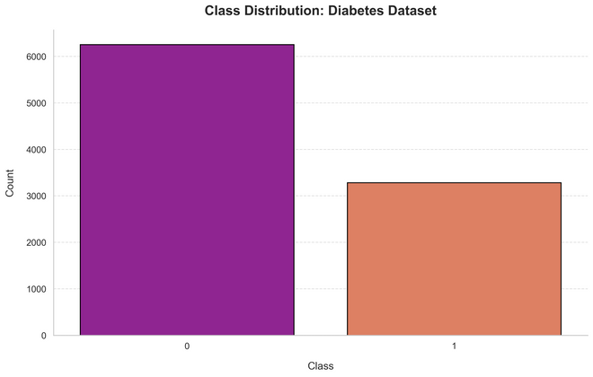
Datasets and Models
FashionMNISTCNN
CNN with Conv + Pool + FC layers
Trained on 28x28 grayscale images (fashion categories)
MNISTMLP
Benchmark dataset for handwritten digit classification
Consisting of 28x28 grayscale images
MLP with 3 FC layers
DiabetesMLP
Tabular data with 16 features
MLP with 3 FC layers

Slide 9
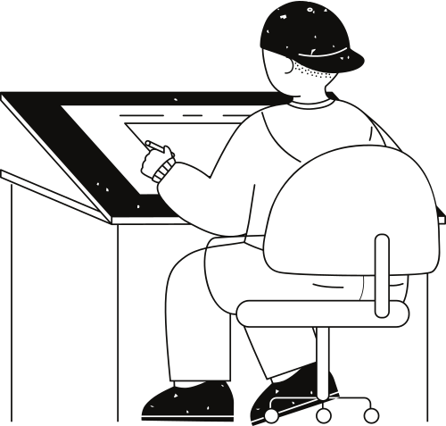
FedSGD: Baseline Model

Slide 10


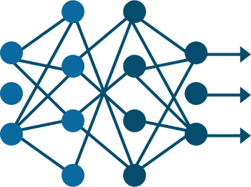



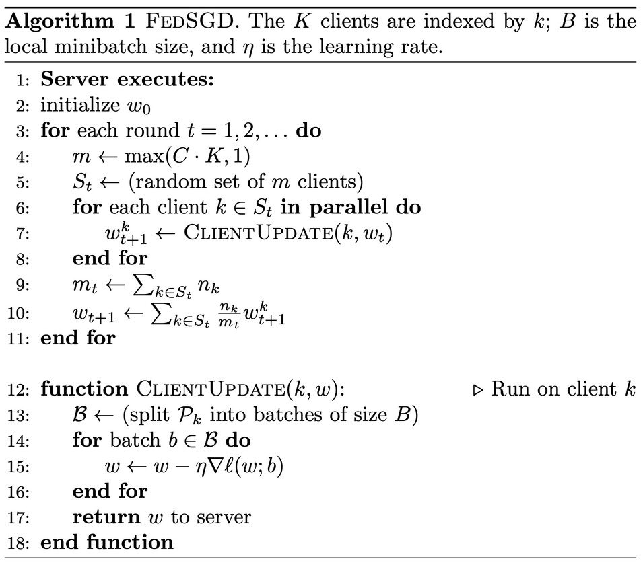

Algorithm
1
Encryption
Server
Parameter
Updates
1
Encryption
Parameter
Updates
1
Encryption
Parameter
Updates

Slide 11
Can we do better?
1
Encryption
Server
Parameter
Updates
Problems to tackle
Communication overhead
Clients send updates after every epoch
1
Encryption
Parameter
Updates
1
Encryption
Parameter
Updates

Slide 12
FedAvg: Enhanced Model

Slide 13
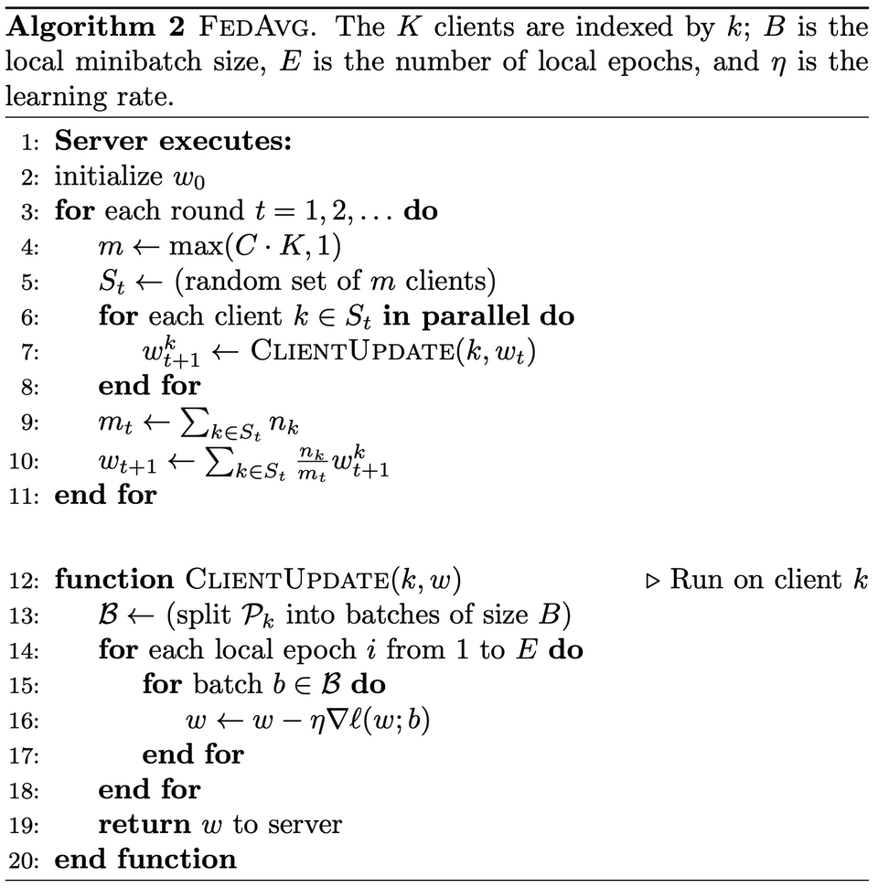
Algorithm
E
Encryption
Server
Parameter
Updates
E
Encryption
Parameter
Updates
E
Encryption
Parameter
Updates

Slide 14
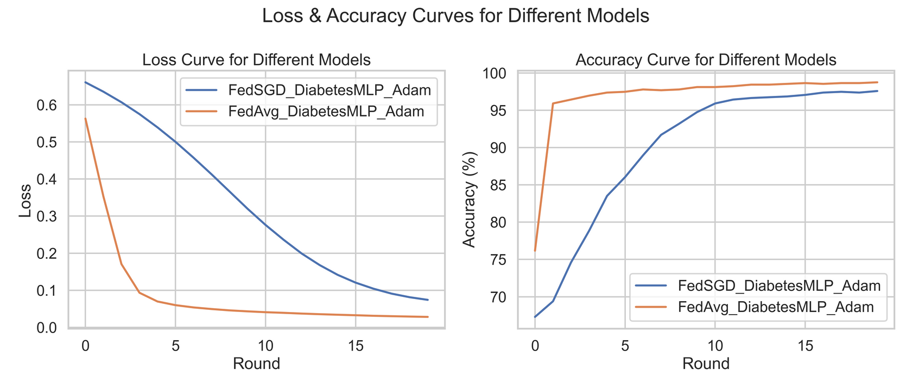
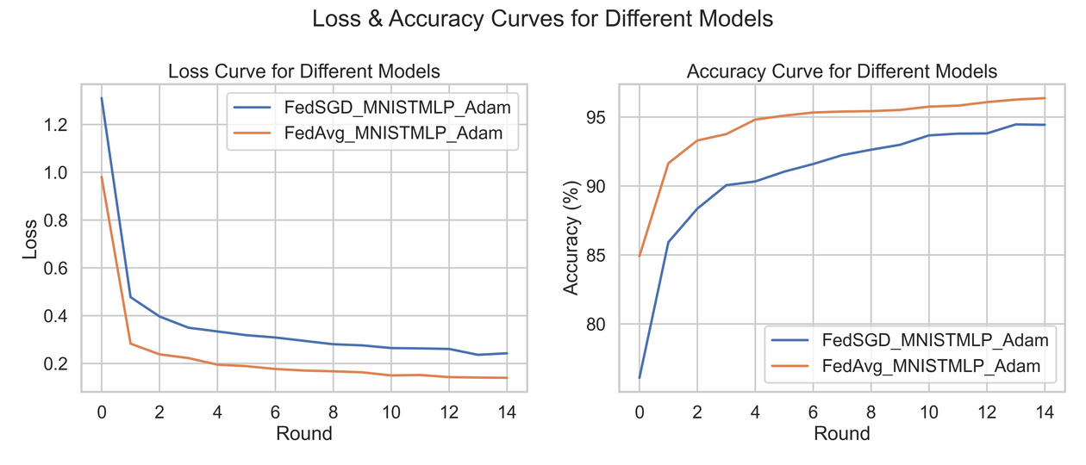
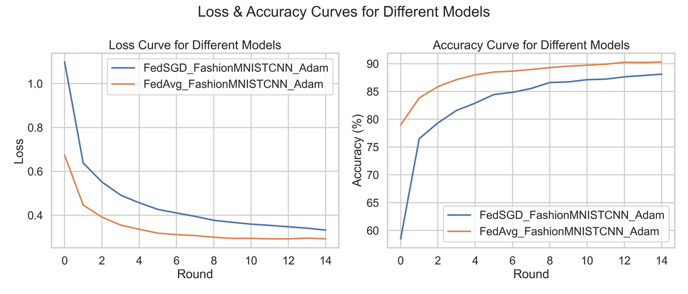
FedSGD vs FedAvg (Accuracy)
Diabetes MLP
MNIST MLP
In case of binary classification task (simpler than multi-class classification), the difference in model performance increases multi-fold
FedAvg takes much less communication rounds than FedSGD to reach a given certain accuracy level. Thus reducing the communication overhead.
FashionMNIST CNN
Note: Even if we compare the number of overall internal rounds (epochs), then also FedAvg performs better than FedSGD.

Slide 15
FedSGD vs FedAvg (Accuracy)
Note: Even if we compare the overall number of internal rounds (epochs) instead of the communication rounds, then also FedAvg performs better than FedSGD.
What FedAvg achieves at the end of 5 communication rounds (total 15 internal rounds) is better than what FedSGD achieves at the end of 15 communication rounds.
Diabetes MLP (FedAvg with 3 internal epohs)

Slide 16
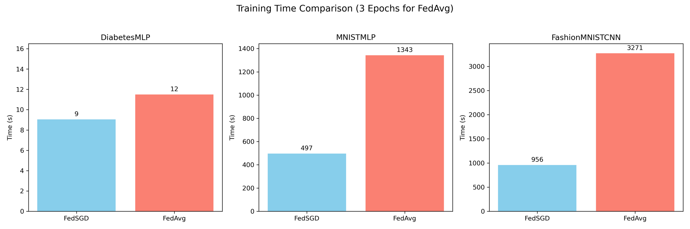
FedSGD vs FedAvg (Time)
Time taken FedSGD vs FedAvg on all 3 models
FedAvg takes approximately 3x the time for FedSGD (Internal epochs = 3 for FedAvg here)
Note: Diabetes MLP is a very small model compared to MNIST MLP/Fashion MNIST CNN so the internal training time for Diabetes MLP is less than the communication overhead, whereas in the other two the communication overhead is negligible as compared to the internal train time. Thus the anomaly in the 3x time for Diabetes MLP.

Slide 17
What if client data is non-uniformly distributed?
E
Encryption
Server
Parameter
Updates
Problems to tackle
Each client is treated equally
What about weights from clients which have bad data?
E
Encryption
Parameter
Updates
E
Encryption
Parameter
Updates

Slide 18
FedAdp: Adaptive Model

Slide 19
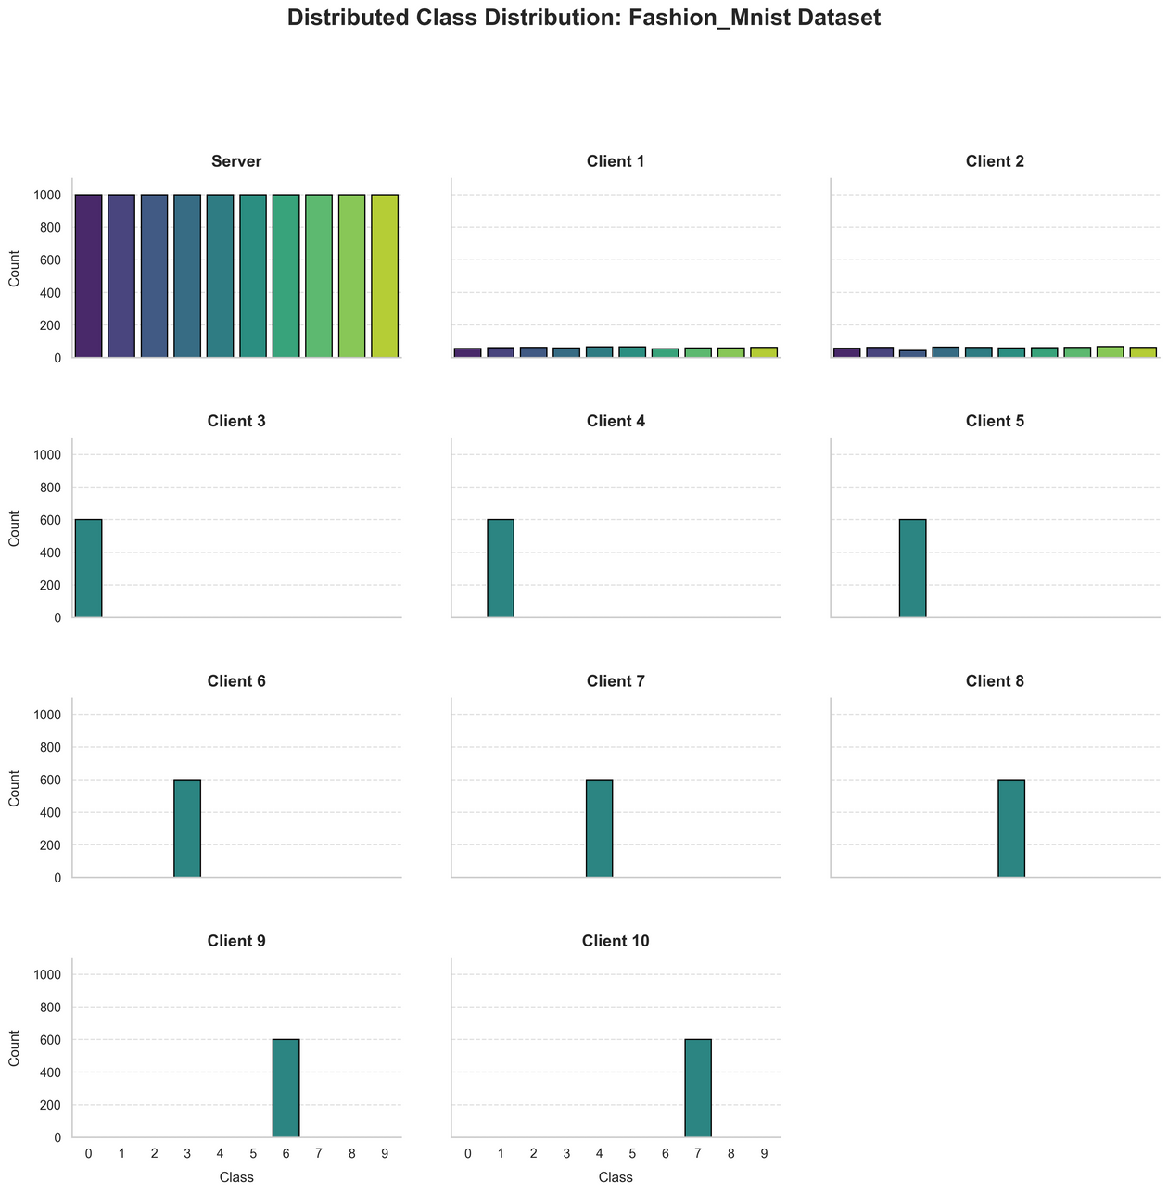
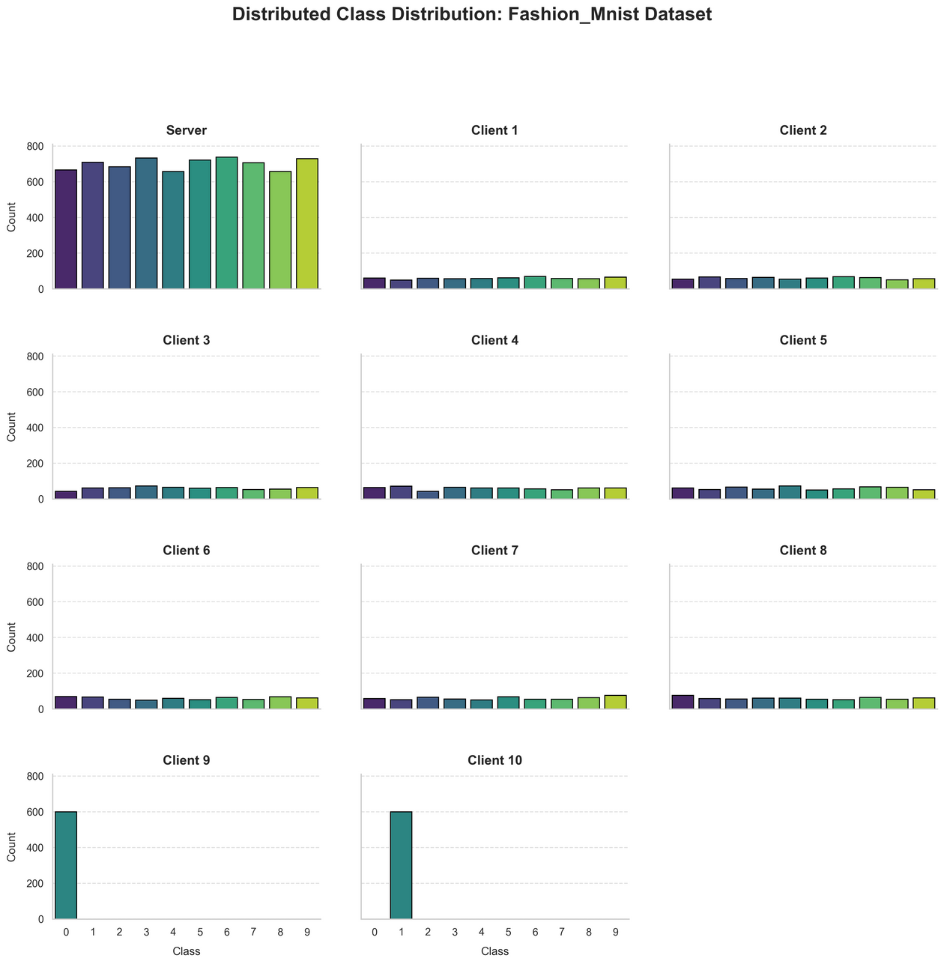
Visualising data distribution
Here number of data samples with each node = 600.
For IID nodes we randomly select 600 data samples for the original Dataset.
For Non-IID nodes we randomly select 600 data samples from a particular class in the original Dataset.
2 IID + 8 Non-IID (FashionMNIST)
8 IID + 2 Non-IID (FashionMNIST)
Note: Since the original distribution is uniform across classes, the random selection for IID nodes also led to uniform distribution (class-wise) in IID nodes data.

Slide 20
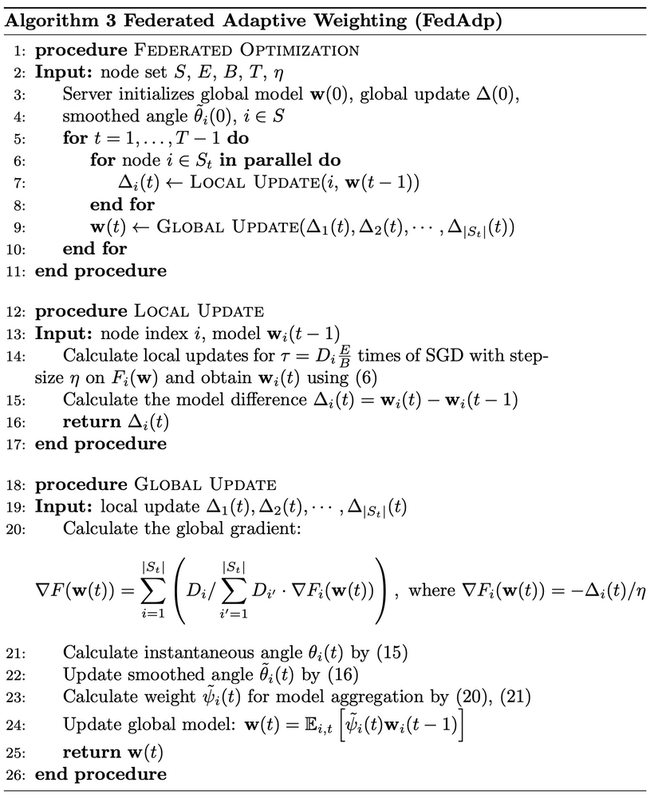
Algorithm
E
Encryption
Server
Parameter
Updates
E
Encryption
Parameter
Updates
Calculate weights based on similarity of weight updates
E
Encryption
Parameter
Updates

Slide 21
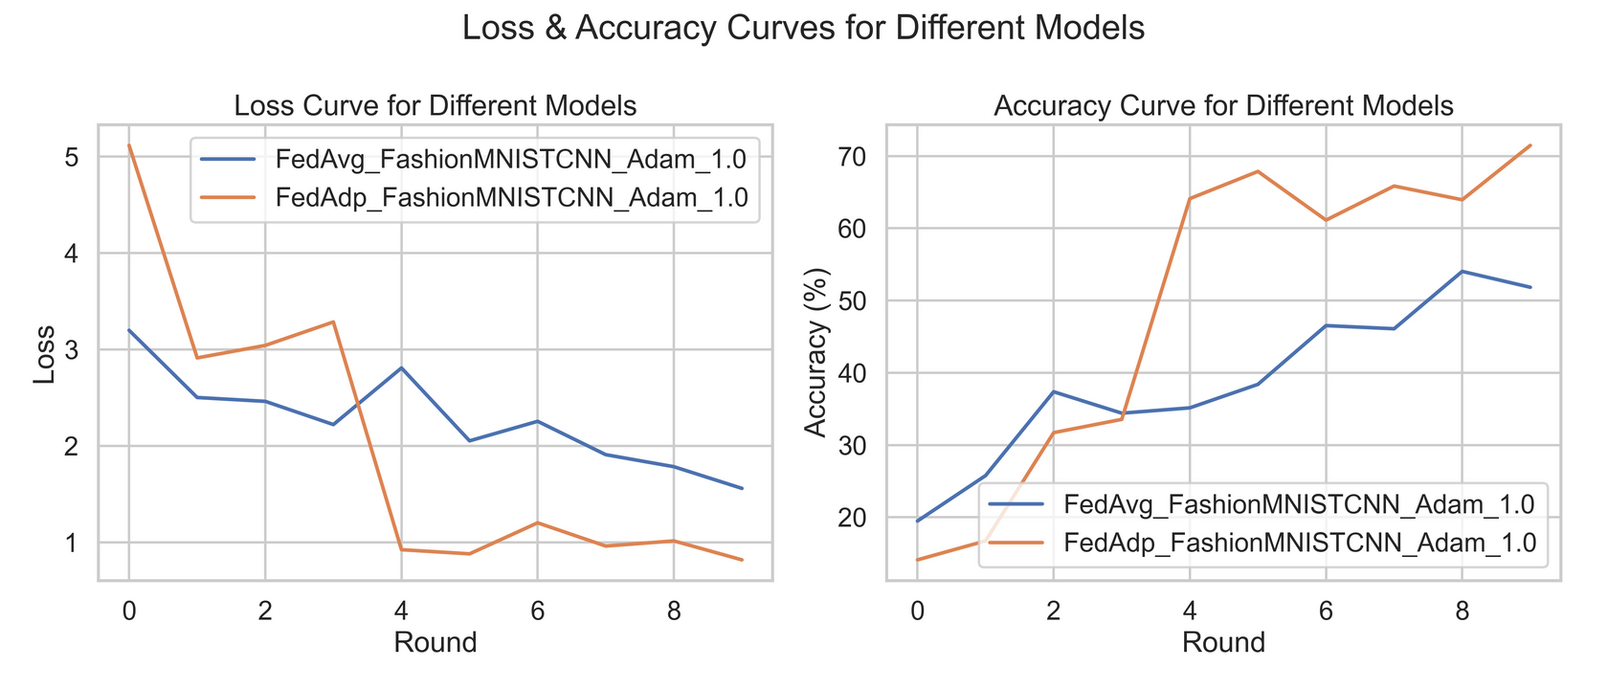
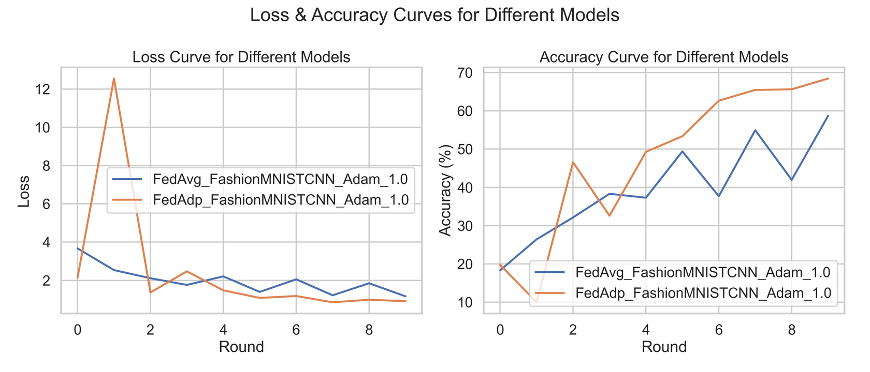
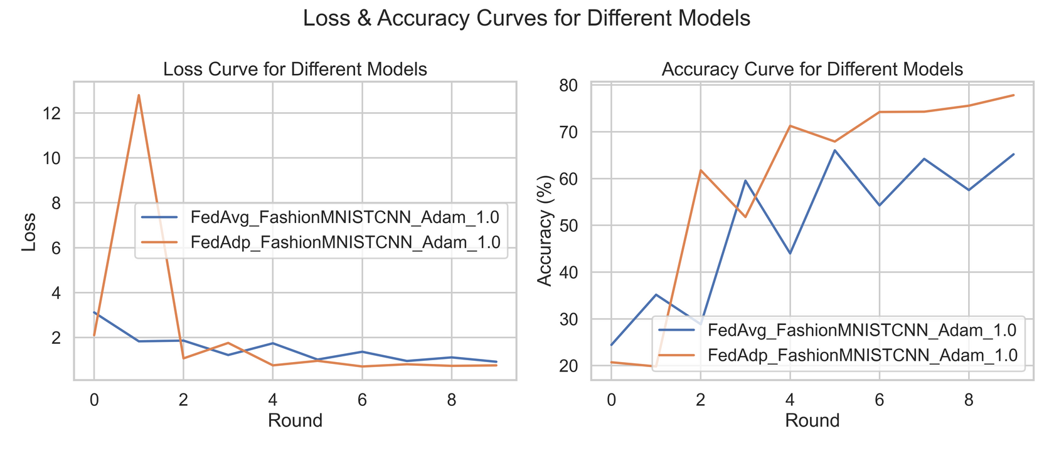
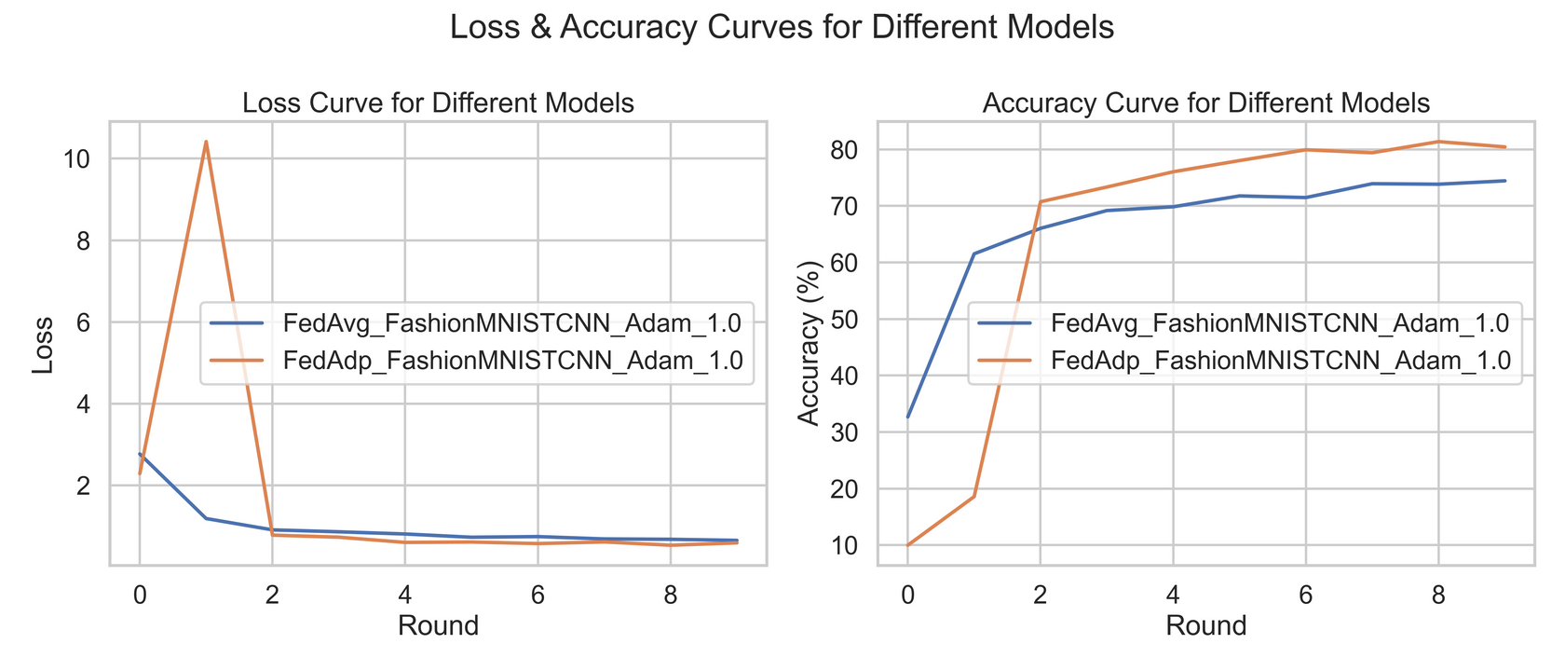
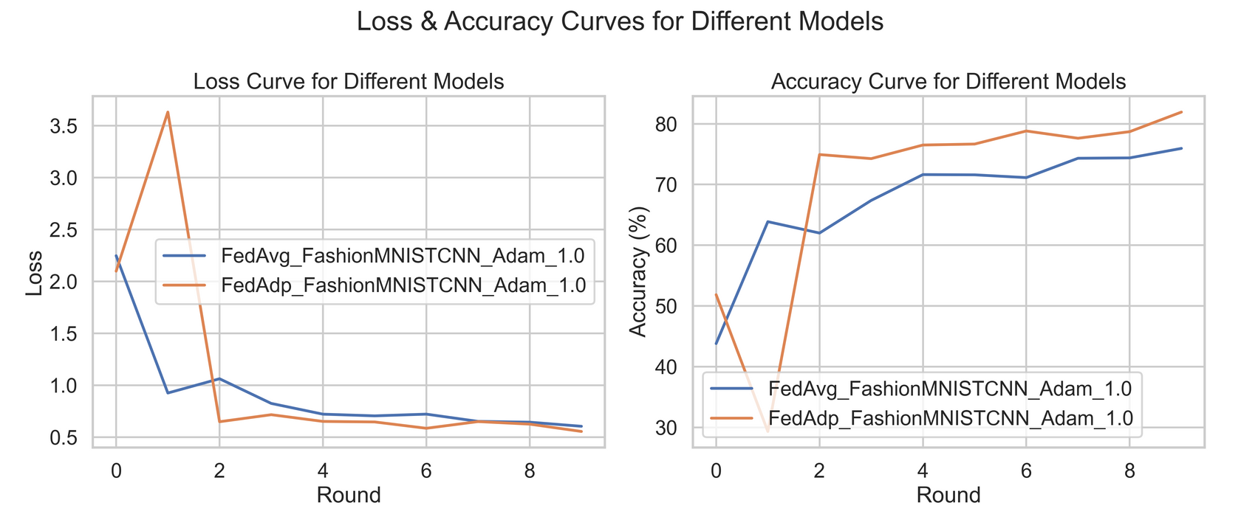
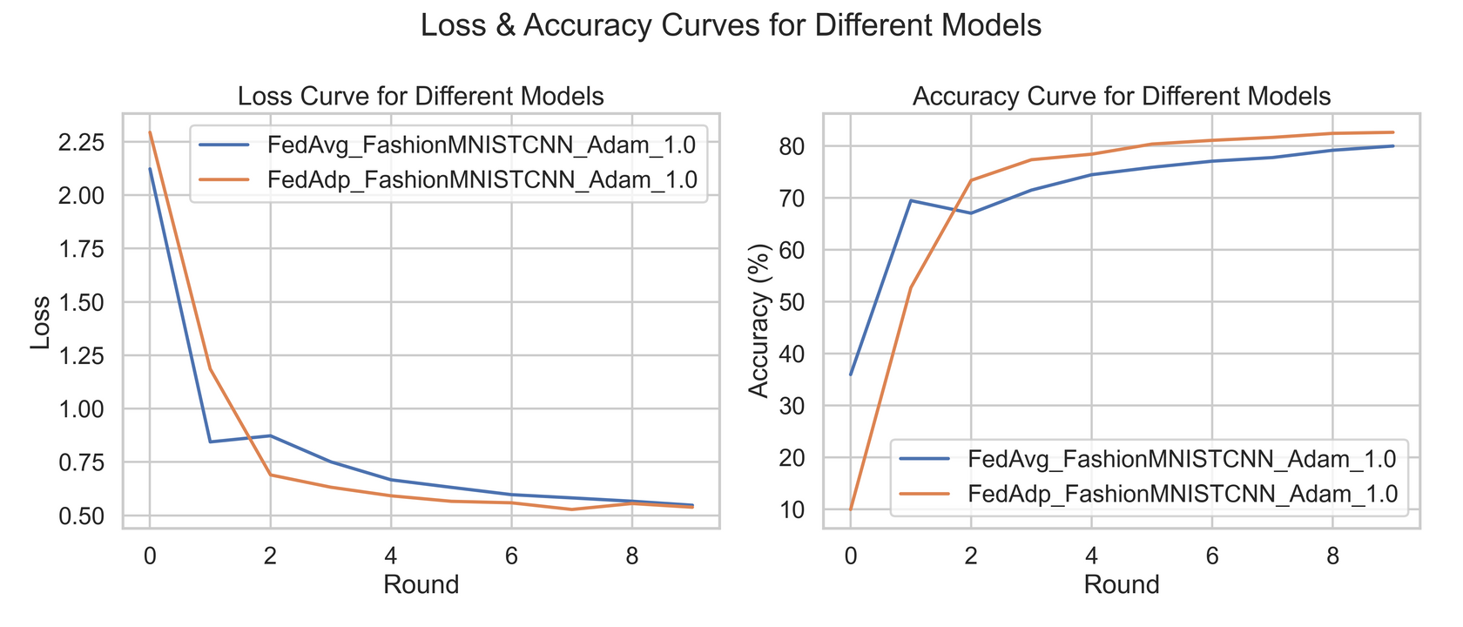
FedAvg vs FedAdp
2 IID + 8 Non-IID
3 IID + 7 Non-IID
4 IID + 6 Non-IID
IID: Equal representation of each class in the data with the node.
Non-IID: All samples of a single class in the data with the node.
In general FedAdp performs better than FedAvg but the disparity increases with the increase in proportion of Non-IID nodes in the training network.
6 IID + 4 Non-IID
7 IID + 3 Non-IID
8 IID + 2 Non-IID

Slide 22
What happens when clients are slow ?
E
Encryption
Server
Parameter
Updates
Problems to tackle
The FL server waits for all clients to finish local training
Slower clients become bottleneck for faster training
E
Encryption
Parameter
Updates
E
Encryption
Parameter
Updates

Slide 23
FedCS: Selective Model

Slide 24
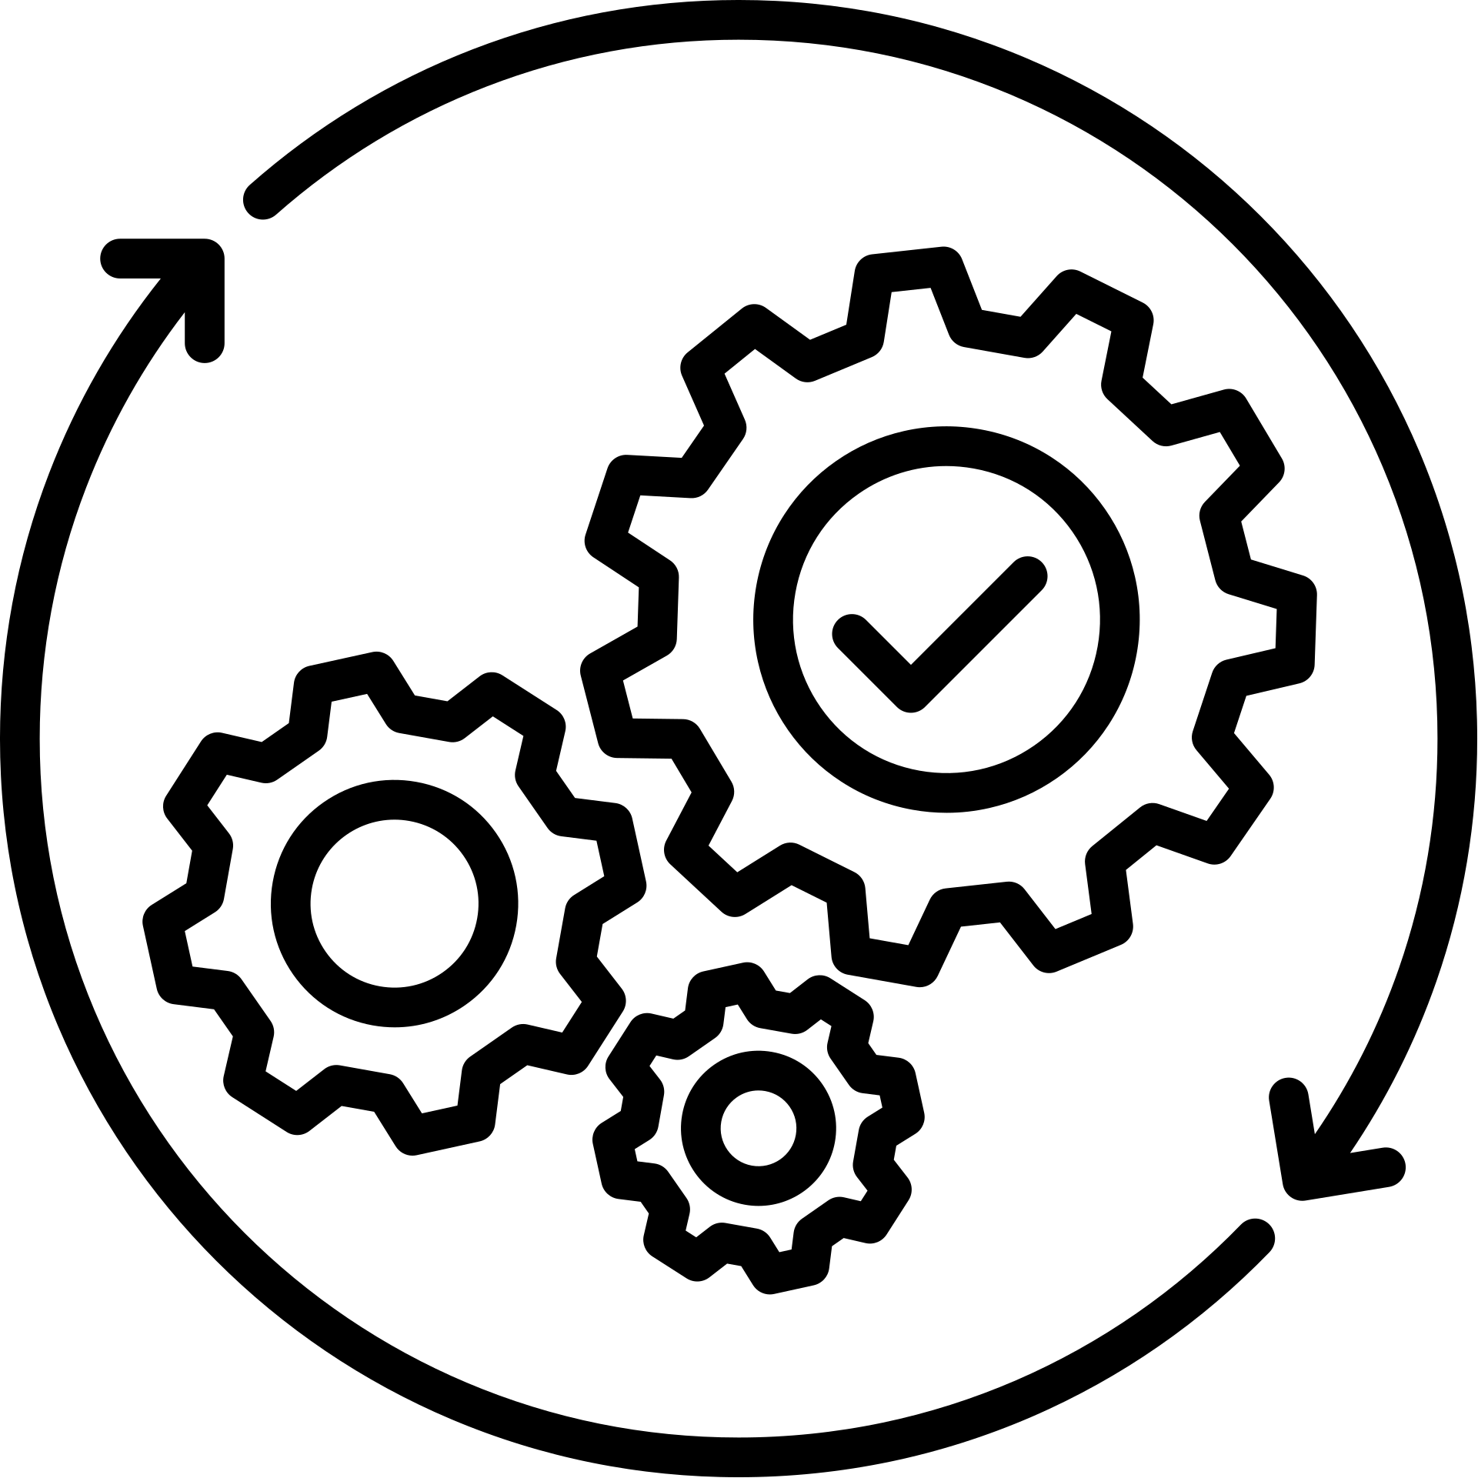
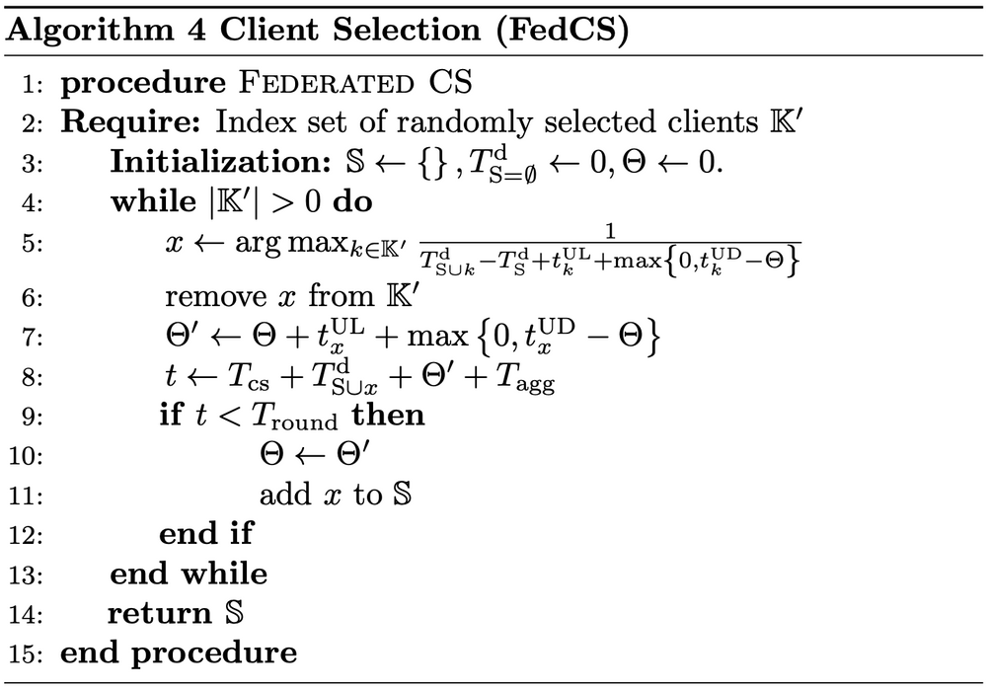


Algorithm
Selected Clients
Select clients to optimize time for current round
E
Encryption
Server
Parameter
Updates
E
Encryption
Parameter
Updates
Client capabilities
E
Encryption
Use weight updates from timely responses only
Parameter
Updates

Slide 25
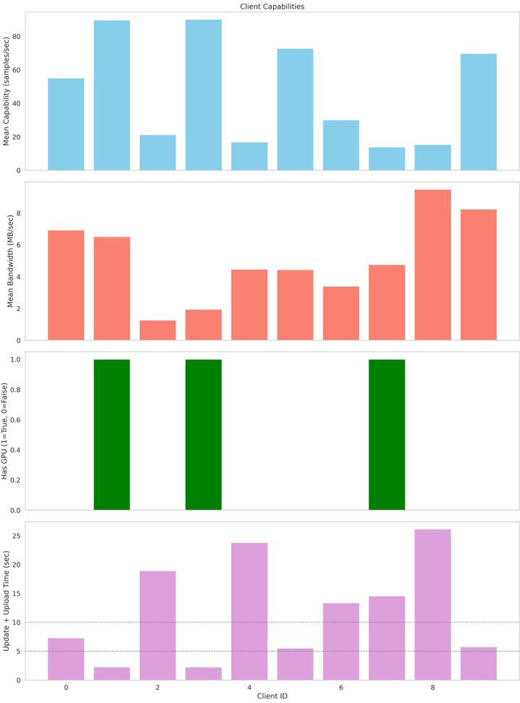
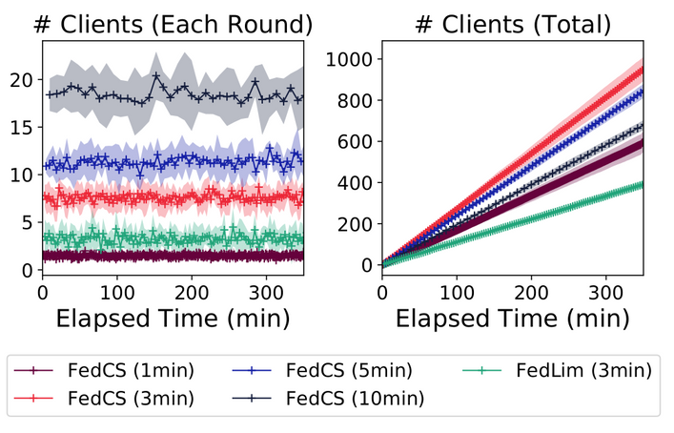
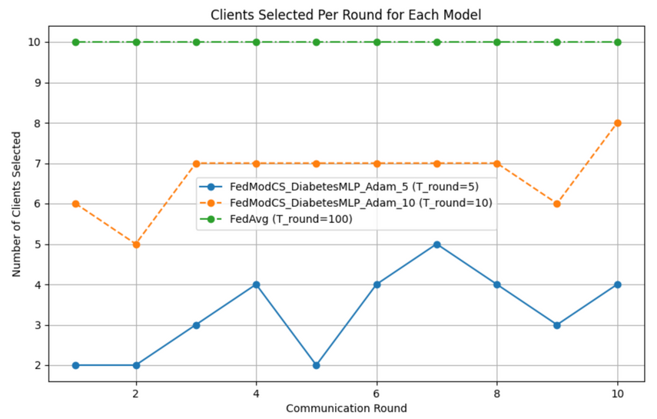
FedCS Ablation Study
Graph showing how number of clients selected increases with increase in T_round (tradeoff between clients involved in single round and overall training time)
Reference plot (From paper)
Distribution of Client Capabilities
Our plot

Slide 26
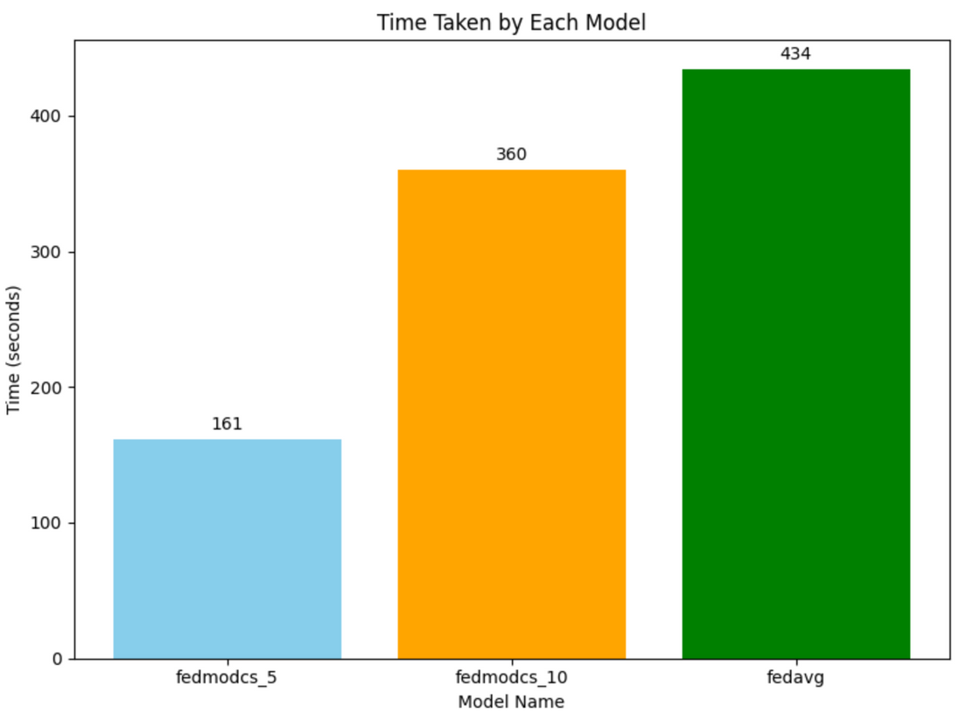
FedCS vs FedAvg
FedCS dynamically selects clients based on upload and update times, ensuring that each communication round completes within the specified t_round.
This avoids delays caused by slow clients, leading to faster overall training.
FedCS with t_round = 5 achieves accuracy same as FedAvg but in less than half the time.
The ability to constrain round duration makes FedCS more suitable for real-world federated settings where devices have heterogeneous capabilities and time constraints.
By adjusting t_round, FedCS allows fine-grained control over the trade-off between speed and accuracy depending on application needs.
Time taken during training to reach a 95% accuracy

Slide 27
Encryption

Slide 28
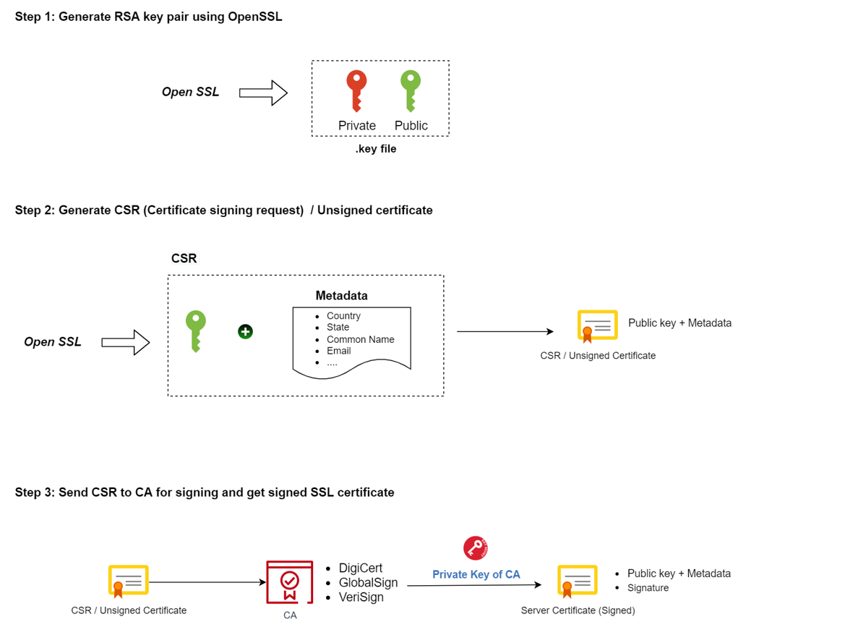
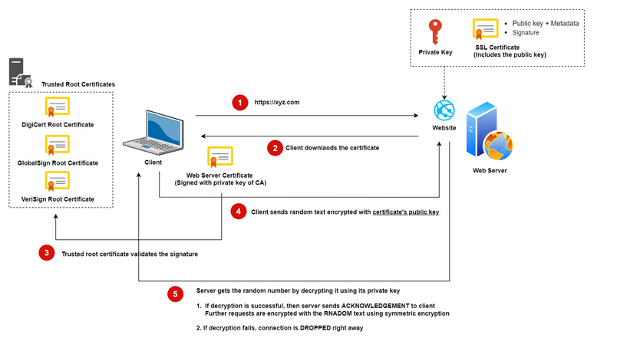
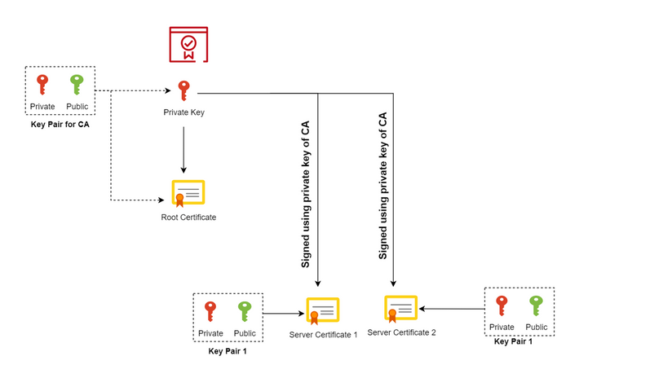
Certificate Verification
Self-signed certificates creation
High-level overview
Reference

Slide 29
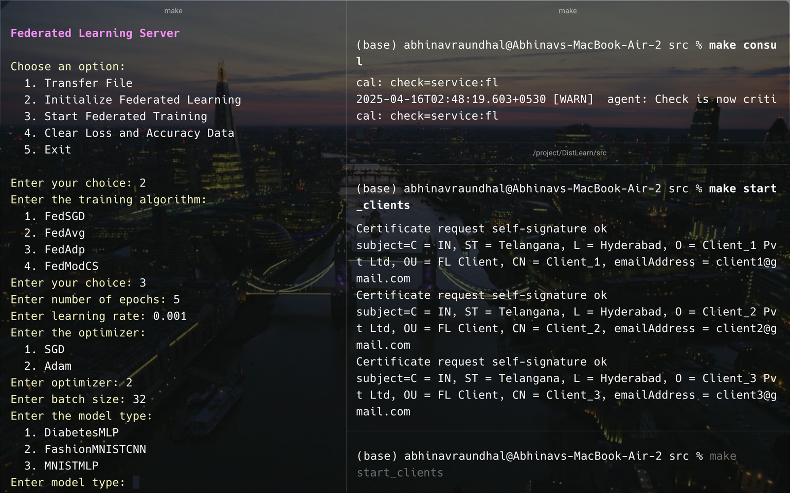
Demostration
FEDERATED LEARNING SERVER
CONSUL
CLIENTS
(Run in the background)

Slide 30
Tasks | Abhinav | Archisha | Vinit
ML Models | R | R | C
gRPC | C | R | R
FedSGD | C | R | C
FedAvg | R | C | C
FedAdp | R | C | R
FedCS | C | R | C
Encryption | C | C | R
Ablation | R | R | R
PPT | R | R | R
Contributions (All Equal)
R = Responsible C = Consulted

Slide 31



Thank you!
Github - DistLearn
Website - DistLearn

